Slide 1
Trends in Reported Crimes – Do We Value Property Over People?
Megan Wilder - Spring 2025

Slide 2
Introduction
As modern societal issues have developed over the past several years, opinions on police efficiency and morality have grown increasingly divided. Many believe the police force is becoming corrupt, and others speculate that it always has been. Despite one’s positive or negative impression of our law enforcement system, it cannot be denied that society’s attitude toward safety and justice is being challenged. For this reason, it is important to investigate the current state of the relationship between crime victims and our judicial system.
How do the general population’s feelings about the police affect their willingness and comfort to report crimes committed against them?
The dataset used for this project was sourced from the U.S. Bureau of Justice and contains survey-gathered information regarding citizens who were victims of a crime in 2021.

Slide 3
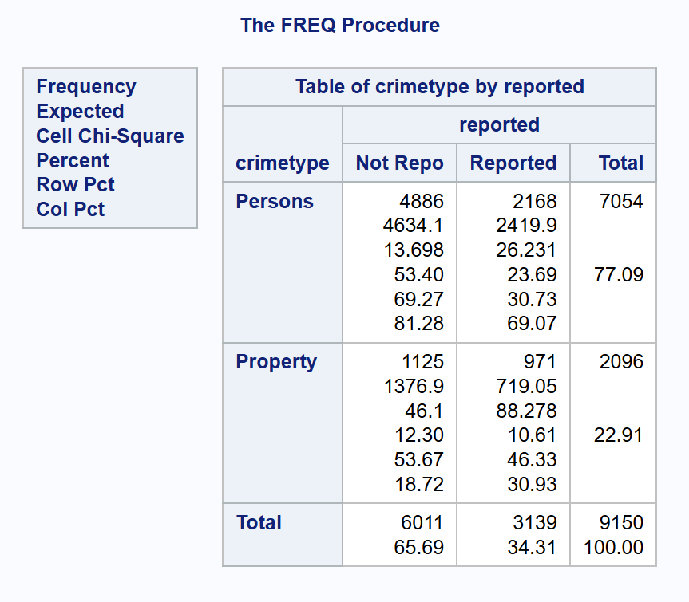
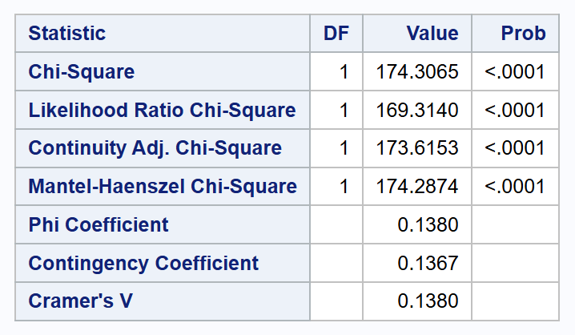
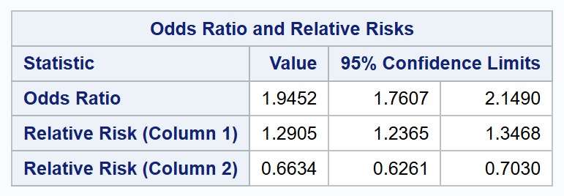
Chi-Square Test
Q: Is there a difference in the rate of reported vs. unreported crimes by type of crime?
Subset observations into two categories:
Crimes against people.
Crimes against property.
Result: There is a significant difference in proportion of whether a crime was reported between the two groups.
Victims of a crime are approximately 94.5% more likely to report a crime against property than a crime against persons.

Slide 4
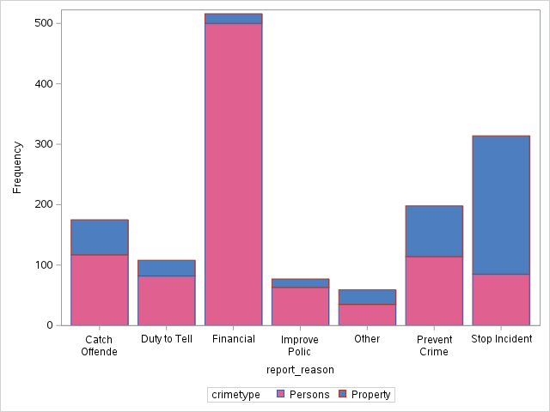
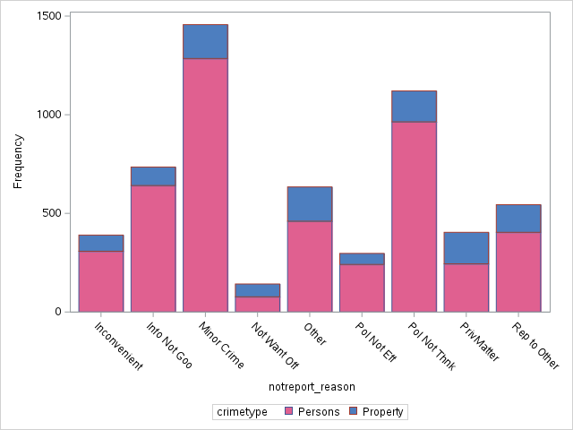
Bar Charts: Reason a Crime Was Reported/Not Reported
Figure 1: Bar chart of frequency of crime type by reason the crime was reported.
Figure 2: Bar chart of frequency of crime type by reason the crime was not reported.

Slide 5
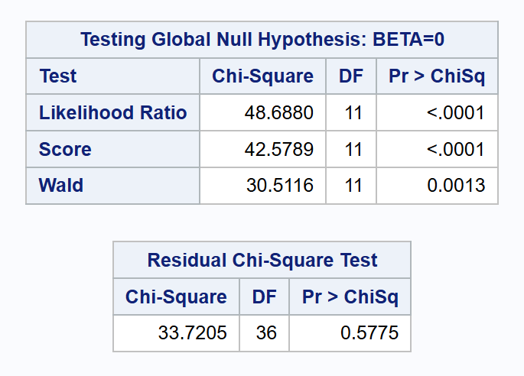
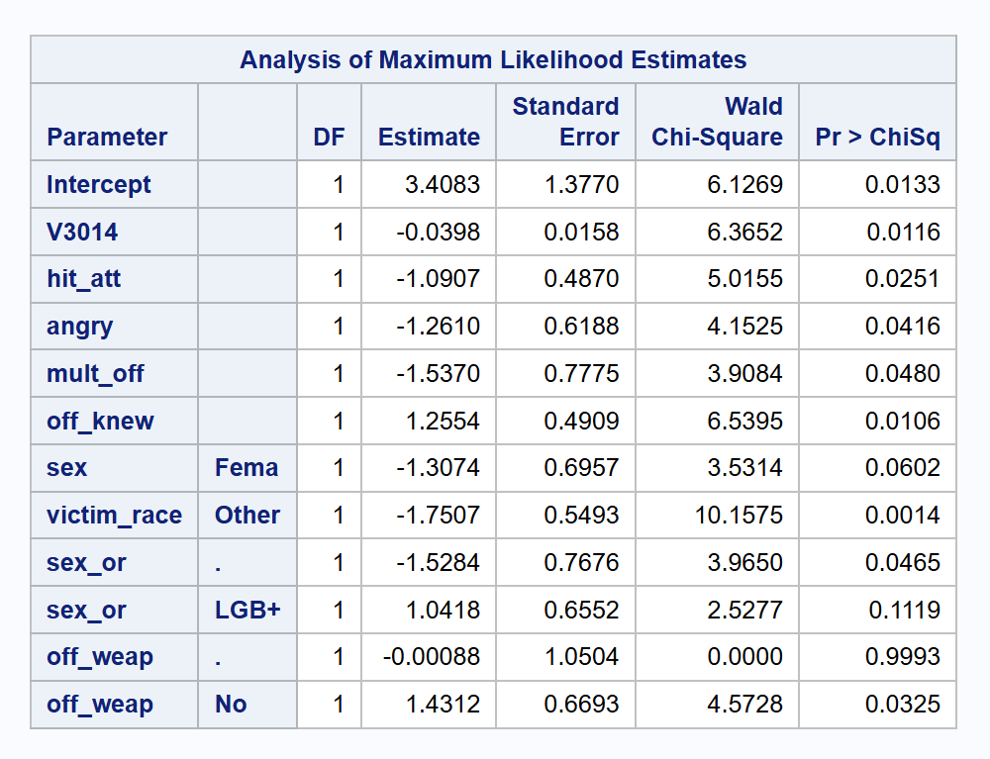
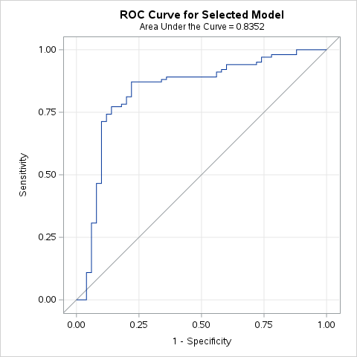
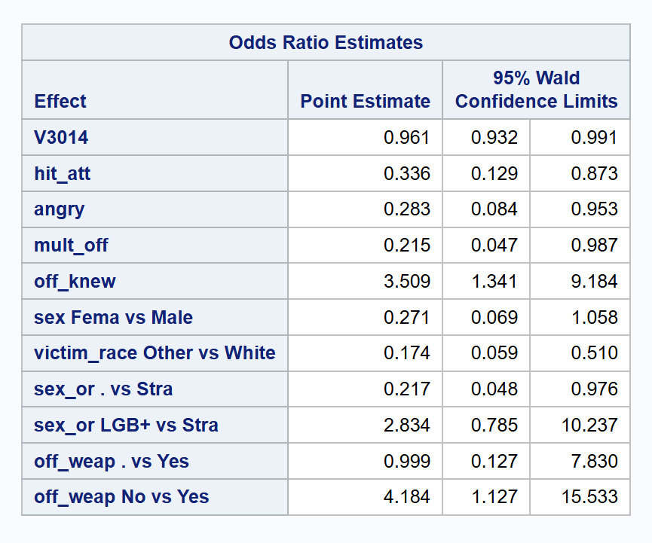
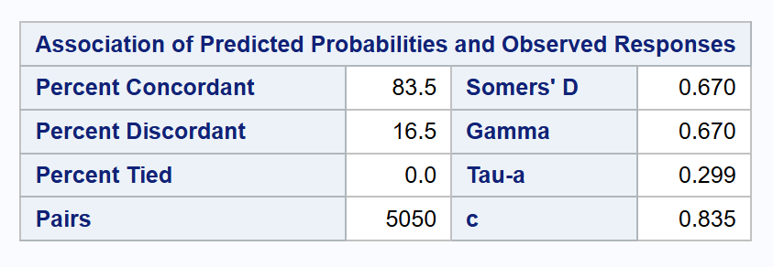
Logistic Regression
Q: What factors affect whether a victim of SA will report a crime?
Subset observations to only those who were victims of a crime defined as SA.
Result: A logistic regression model was created, and the odds ratios of significant variables were investigated.
This model has a c-statistic of 0.835.
Figure 1: Logistic regression global hypothesis test.
Figure 2: Logistic regression variable estimates and p-values.
Figure 3: ROC curve for final logistic regression model.
Figure 4: C-statistic results for final logistic regression model.
Figure 5: Logistic regression variables odds ratio estimates.

Slide 6
Discussion
Victims who are more likely to report this type of crime:
Younger victims
Victims who knew the offender
Cases where the offender had a weapon
Victims who are less likely to report this type of crime:
Victims who were physically attacked
Cases where there were multiple offenders
For every 1 year older a victim of sexual assault was, the likelihood that they reported the crime decreases by about 3.9%.
Victims who were hit or attacked by the assaulter were approximately 66.4% less likely to report the crime than those who were not.
In cases where there are multiple offenders, the victim is about 0.78% less likely to report a crime than if there is a single offender.
If a victim knew the offender, they were about 3.5 times more likely to report the crime than if they did not know the offender.
In cases where the offender had a weapon, victims were about 4.2 times more likely to report the crime than if the offender did not have a weapon.

Slide 7
Conclusion

Slide 8


Links
Github:
LinkedIn:

Slide 9
